Slide 1
To help families solve one of their biggest challenges in the journey to senior care by offering an easier, less stressful way to sell mom’s (or dad’s) house to get the senior care as soon as possible.
OUR MISSION

Slide 2
THE JOURNEY TODAY – SELLING A HOUSE

Slide 3
The family just got the news

Slide 4
Crisis Mode &
Emotional State
Notes:
The family didn’t plan and never been through this, what they are going through

Slide 5
The family lives ~400 Miles Away (6 Hours)

Slide 6
Dealing with
the stuff

Slide 7
PROJECT JOB COST RESALE VALUE COST RECOUPED
We can rehab it!
Getting Bids
Funding Repairs
No Shows
Notes:
They’ve seen the shows, they know a guy, we can do this. And then 3 months later, they are still at the same place, no shows with contracts, they painfully realize

Slide 8
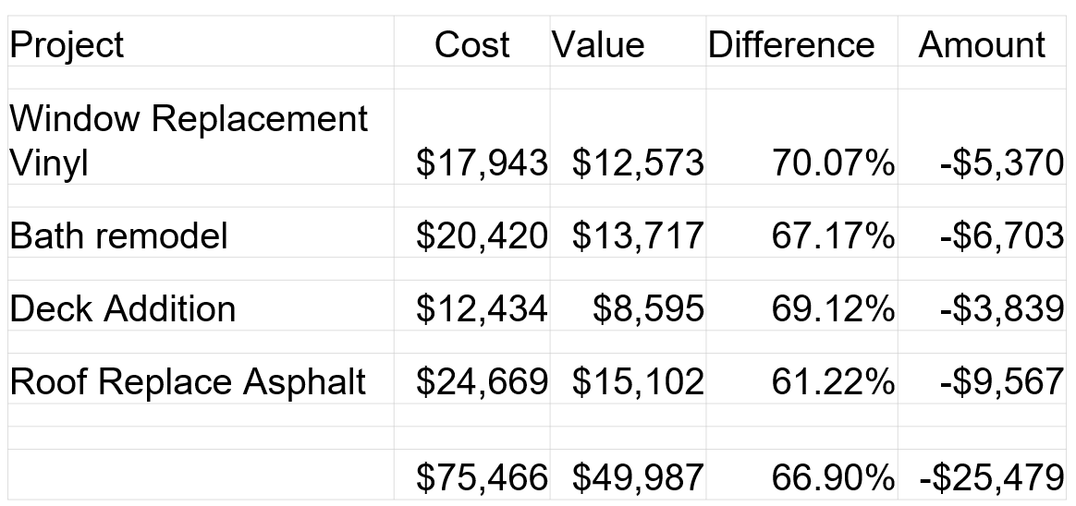
MOST FAMILES DON’T REALIZE
COST VS. VALUE.

Slide 9
Same Money, Less Stress
Commissions
& Closing Cost
Rehab & Cleanout Expenses
Cost to the Family
Taxes, Insurance, mortgage, maintenance
Family
Proceeds
Money Received
Family
Proceeds
Money Received
RETAIL VALUE
Family receives
the proceeds
6 month earlier
Listing
Agent

Slide 10
SHORTENING THE JOURNEY

Slide 11
Mom’s House Senior Certified Network

Slide 12
COMPASSION, NOT COMMISSION.
No real estate agents involved and no realtor fees.
Never any fees for our service for the family or community
We compassionate advisors to families throughout the process.

Slide 13
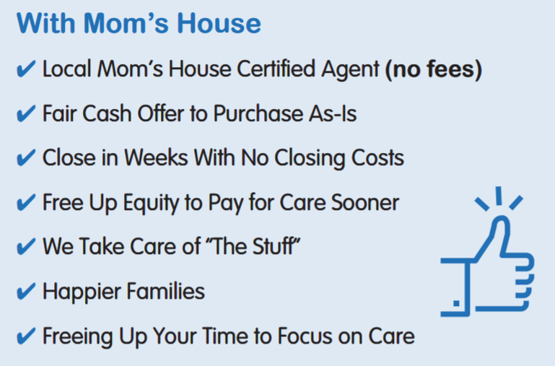

Slide 14
How we can help
Refer a prospective resident
We connect family with a certified buyer
Buyer meets Face to Face with family
We offer communities a status report
Buyer purchases house within 30 days
Resident moves in faster

Slide 15
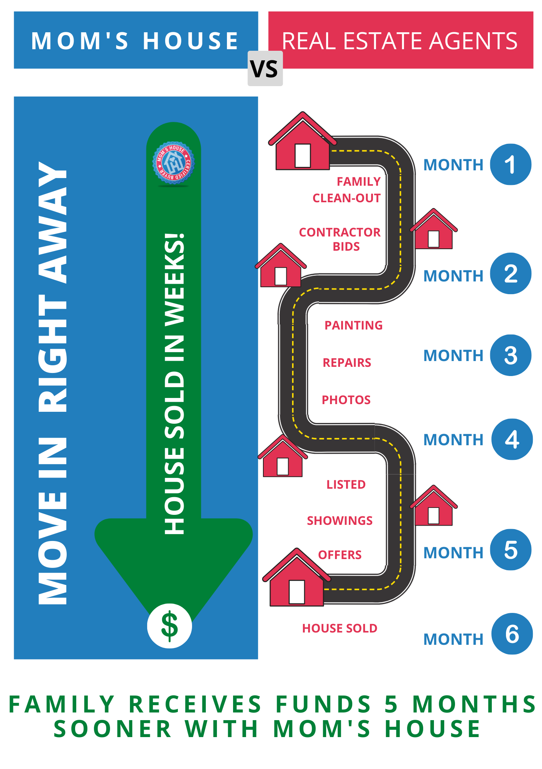
THE JOURNEY
HELPING SENIORS
MOVE IN FASTER
WEEKS VS. MONTHS

Slide 16
ADD YOUR LOGO
Empower families with options to ease the journey while transitioning a senior to care faster.

Slide 17
Our commitment to continuing education

Slide 18
Mom’s House
Certification Program
3 day live training
Experience required
500-page curriculum
On-line Academy
Private Community
Mentorship Term
Continuing EDU

Slide 19
www.payingforlongtermcare.com
Notes:
I’m also involved with the paying for long-term care project, I’ve partners with Ben Rao (Rayo) who is a national thought leader the senior living industry and an advocate for families to help them get to free resources to make the transition

Slide 20
Free Family Resources

Slide 21
Free Family Resources

Slide 22
Free Family Resources

Slide 23
Free Family Resources

Slide 24
Free Family Resources

Slide 25
Free Family Resources

Slide 26
Resources to help families and Seniors transitioning in to long-term care
FUNDING
FOR SENIORS
WITH CANCER
Ben Rao - brao@payingforlongtermcare.com 816-585-7027

Slide 27
Getting Started
Go to MomsHouse.com and download our
brochure and start moving seniors in sooner
Ben Rao
ben@momshouse.com
816-585-7027

